Slide 1
NASA’s ASTEROID CLASSIFICATION Classifying whether an asteroid is hazardous or not
TEAM 5: Data Diggers
VISHAL BAKSHI
PRATIKSHA DANGE
QIBIN HUANG
SUDHANSHU DOTEL

Slide 2
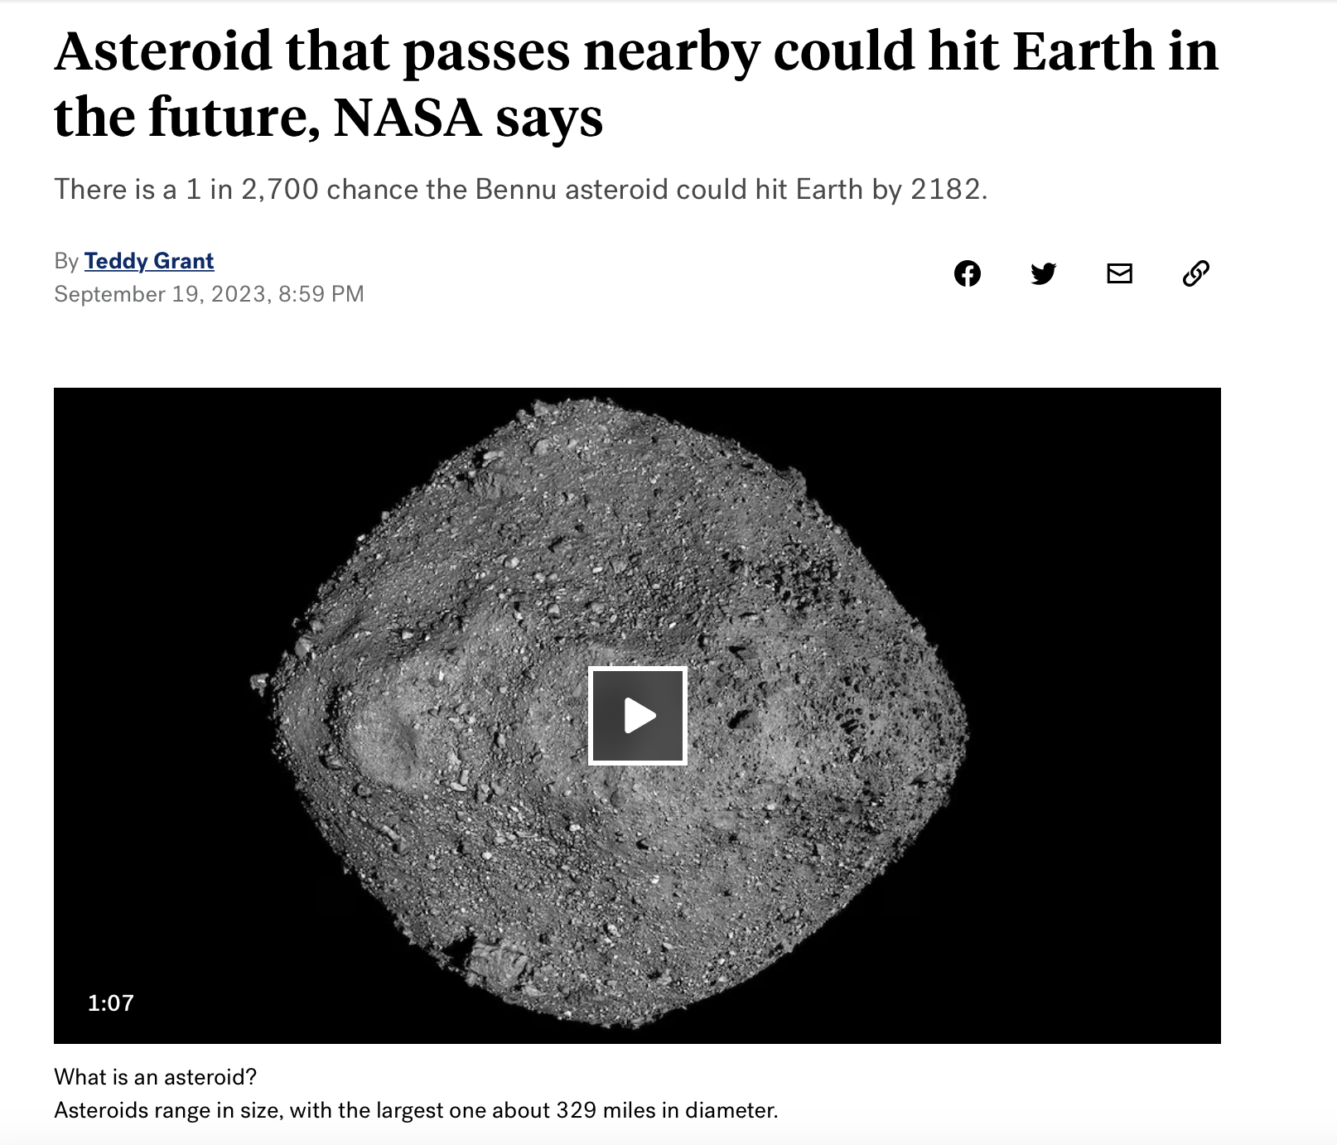
Reason to choose this domain:

Slide 3
OBJECTIVE :
We aim to analyze this dataset to learn about asteroid properties and classifications, especially those labeled as potentially hazardous or non-hazardous.
Our main goals are to understand the asteroids' physical and orbital characteristics and to pinpoint the key factors that affect asteroid classification.

Slide 4
DATASET:
Our dataset is available as Nasa Asteroids Classification at Kaggle. All the data is from the (http://neo.jpl.nasa.gov/).
The dataset consists of 4000 data instances (rows) and 40 features (columns).
'Neo.Reference.ID', 'Name', 'Absolute.Magnitude', 'Est.Dia.in.KM.min.', 'Est.Dia.in.KM.max.', 'Relative.Velocity.km.per.sec', 'Orbit.Uncertainty', 'Minimum.Orbit.Intersection','Mean.Anomaly','Jupiter.Tisserand.Invariant', 'Epoch.Osculation', 'Eccentricity', 'Semi.Major.Axis', 'Inclination', 'Asc.Node.Longitude', 'Perihelion.Distance', 'Perihelion.Arg', 'Aphelion.Dist', 'Perihelion.Time', 'Mean.Motion', 'Hazardous'

Slide 5
What Our Data Tell US:
● Absolute Magnitude: The brightness of the star.
● Estimated Diameter (Min and Max): minimum and maximum estimated diameter of an asteroid in KM..
● Relative Velocity: Velocity of the asteroid.
● Minimum Orbit Intersection: represents the minimum distance at which the asteroids orbit intersects the earths orbit.
● Jupiter Tisserand Invariant: A scale that tells how much Jupiter's gravity is affecting an object in space. So lower the JTI Value, the farther it is from Jupiter.
● Orbit Uncertainity: A measure of the uncertainty in measuring the asteroid's orbit parameters.

Slide 6
What Our Data Tell US:
Eccentricity: Decides the shape of the asteroid’s orbit.
Perihelion Distance: distance of asteroid from the sun when it is closest to the sun
Aphelion Distance : distance of asteroid from the sun when it is farthest from the sun
Semi major axis: represents how big the asteroid’s orbit is.
Mean Motion: How the asteroid moves in its orbit in terms of angular velocity.

Slide 7
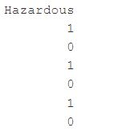
Data Preprocessing
We have performed the data pre-processing in two ways:
Converting the Hazardous Columns into integer and categorical.
Subsetting the variables which are relevant to the analysis.

Slide 8
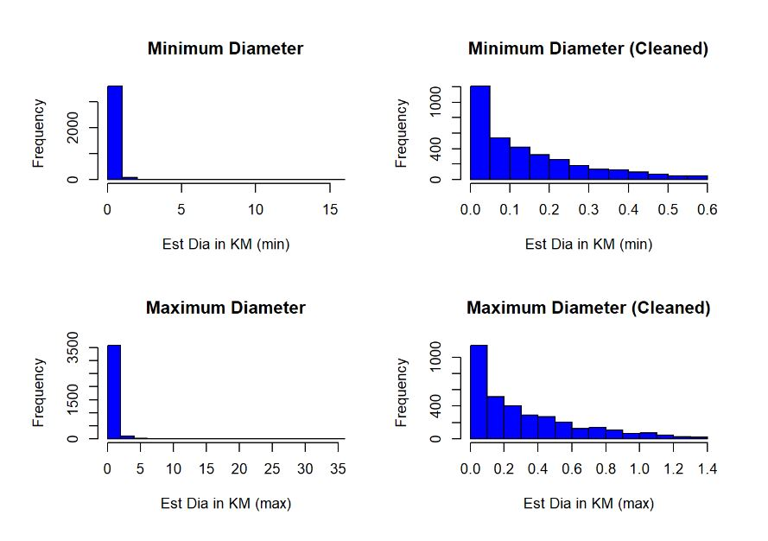
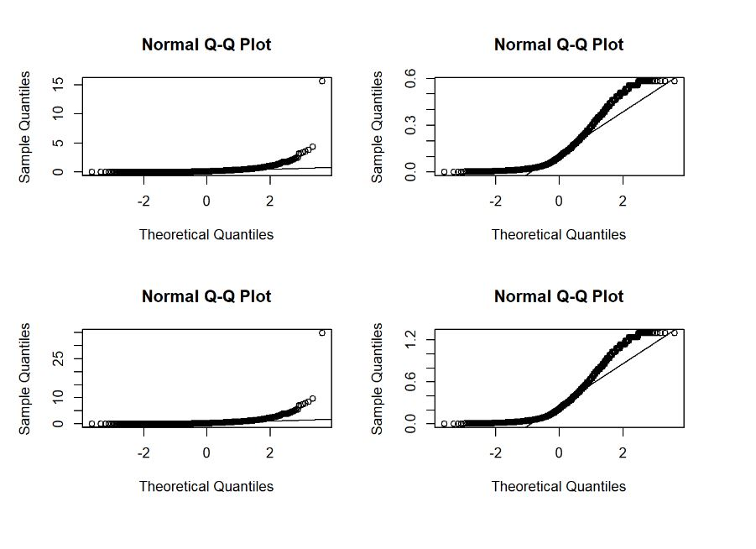
Outlier Check

Slide 9
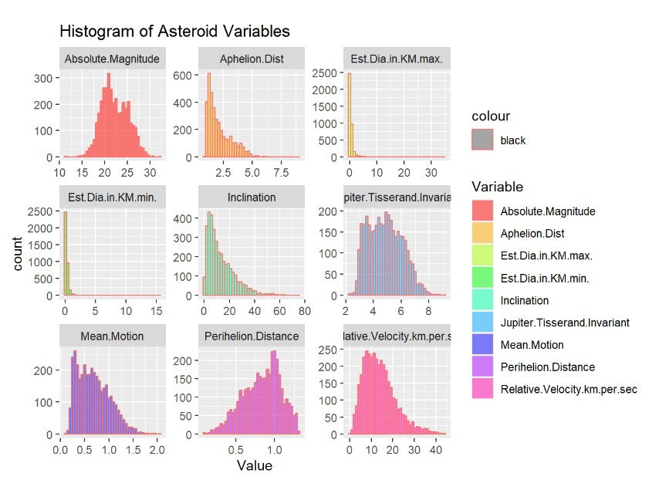
Histogram of Asteroid dataset variables
The histogram plot has the distribution of the important variables present in the dataset.
Absolute magnitude has its peak data points between the values 20-25
Aphelion Distance has its peak data points between the values 0-2.5
Perihelion.Distance has its peak data points approximate near 1.0.
Relative.Velocity.km.per.sec has its peak data points between the values 5.0-10.0

Slide 10
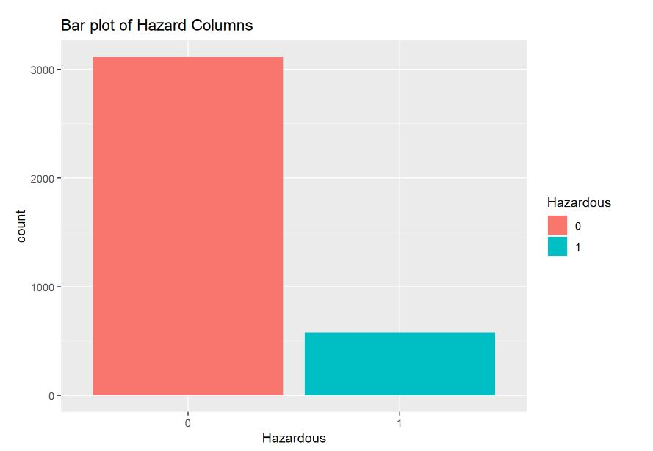
Bar Plot of Hazardous Classification
The bar plot clearly explains about the data distribution of hazard columns as 0 and 1.
0 : represents Non Hazardous
1 : represents Hazardous

Slide 11
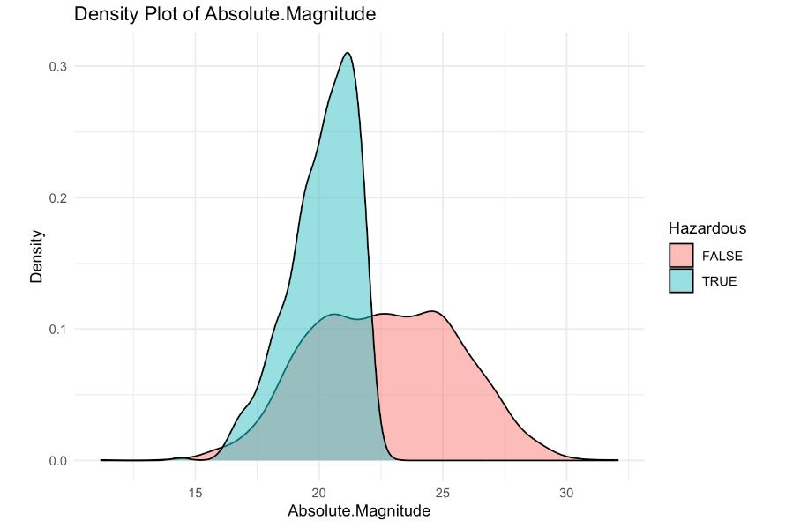
Checking For Patterns using Density Plots
From the density plot, we can derive that absolute values between 15 to 22.5 has higher density for being hazardous
Absolute values from 22.5 to 30 has less impact of being hazardous.

Slide 12
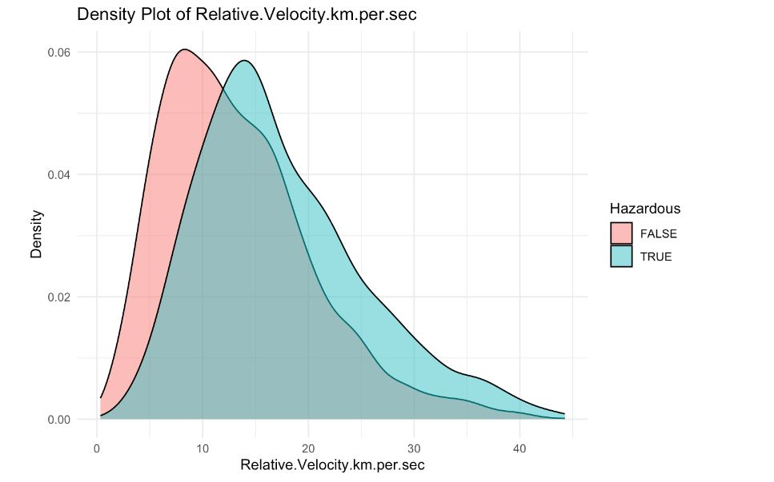
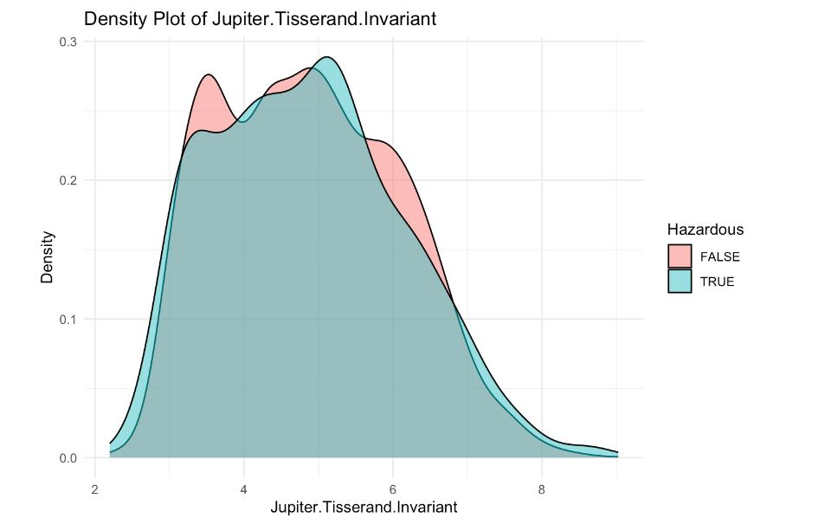
Checking For Patterns using Density Plots

Slide 13
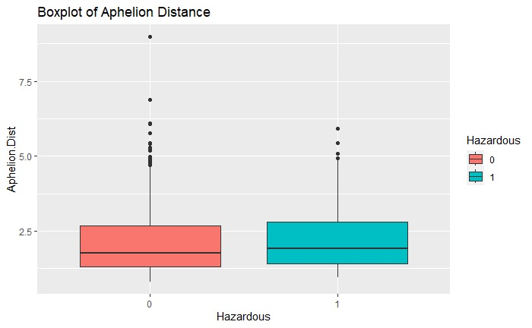
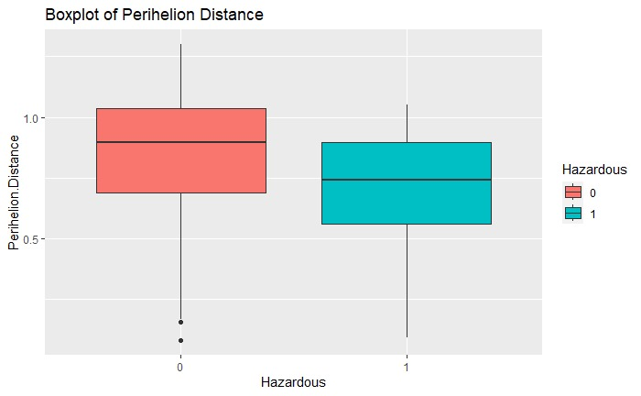
Smart Question 1: How do the hazard classifications of asteroids relate to their proximity to Earth in terms of Perihelion and Aphelion distances?

Slide 14
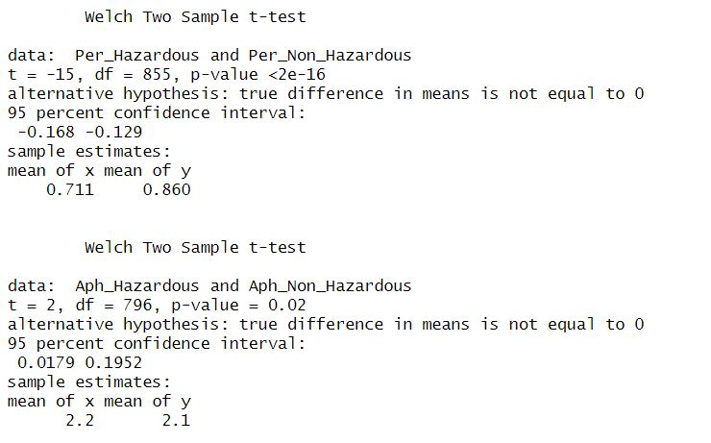
Test Results for Smart Question 1:
Perihelion Distance: There is an observable trend where hazardous asteroids tend to exhibit smaller perihelion distances when compared to their non-hazardous counterparts.
Aphelion Distance: A subtle yet statistically significant variation emerges, with asteroids possessing higher aphelion distances demonstrating a slightly increased likelihood of being classified as hazardous. Nevertheless, it's important to note that the means of the two groups remain closely aligned. Thus, we cannot definitively attribute higher aphelion distance as the sole determinant of an asteroid's hazardous classification.

Slide 15
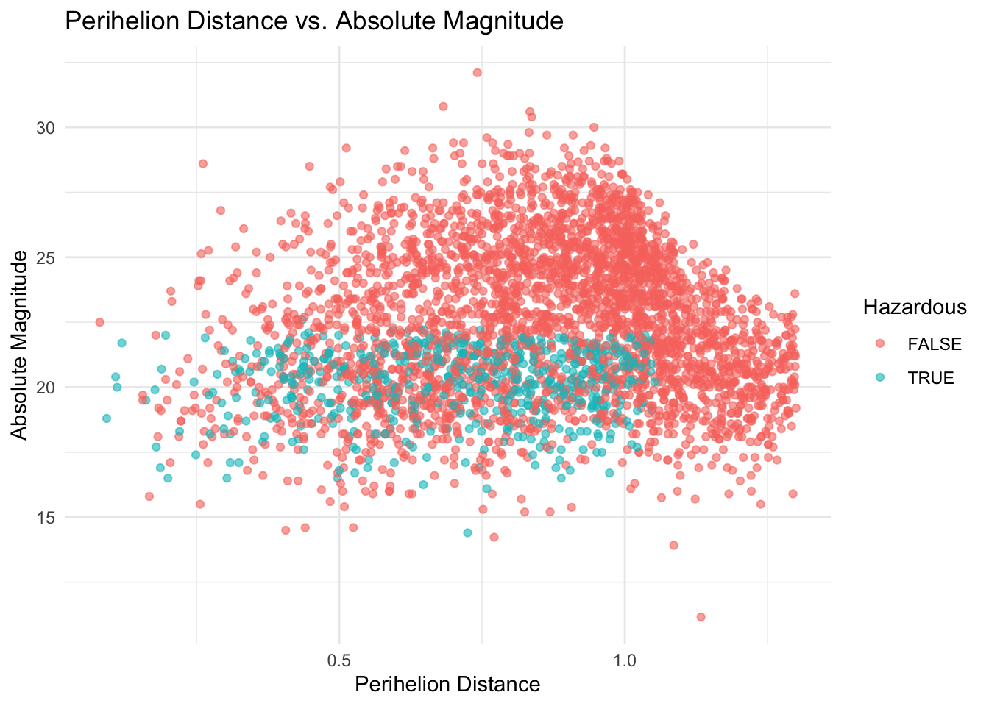
Smart Question 2: Does the impact of Perihelion Distance vary with the absolute magnitude.
According to the scatter plot between Absolute Magnitude and Perihelion Distance.
Values below 22.5 in absolute magnitude and highest values in perihelion distance show greater impact on earth by being hazardous.

Slide 16
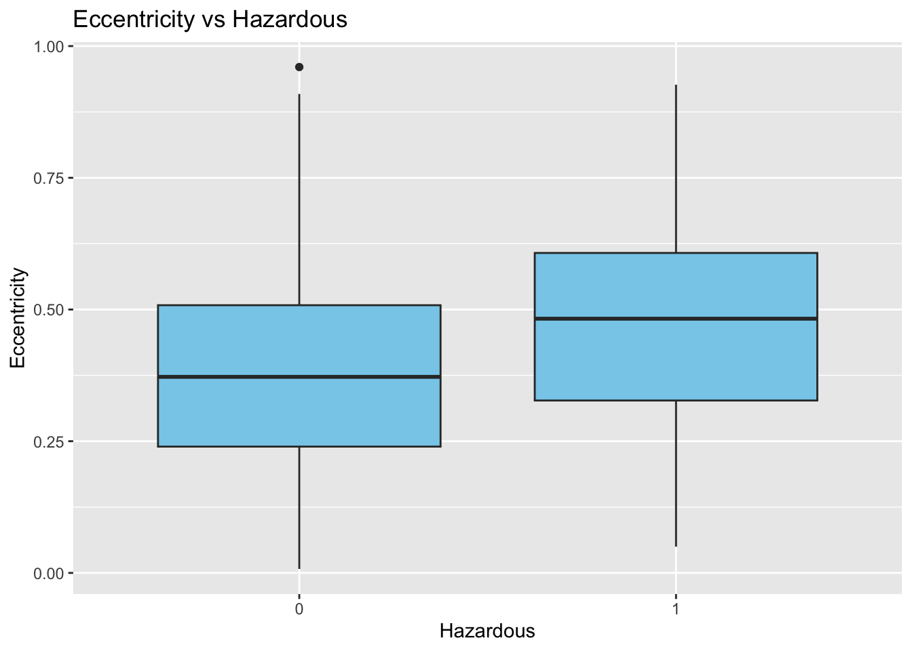
Smart Question 3: Can we measure the impact of eccentricity and perihelion distance on asteroid hazard classification using statistical tests?
Hazardous asteroids has higher Eccentricity
Non-Hazardous asteroids has lower Eccentricity

Slide 17
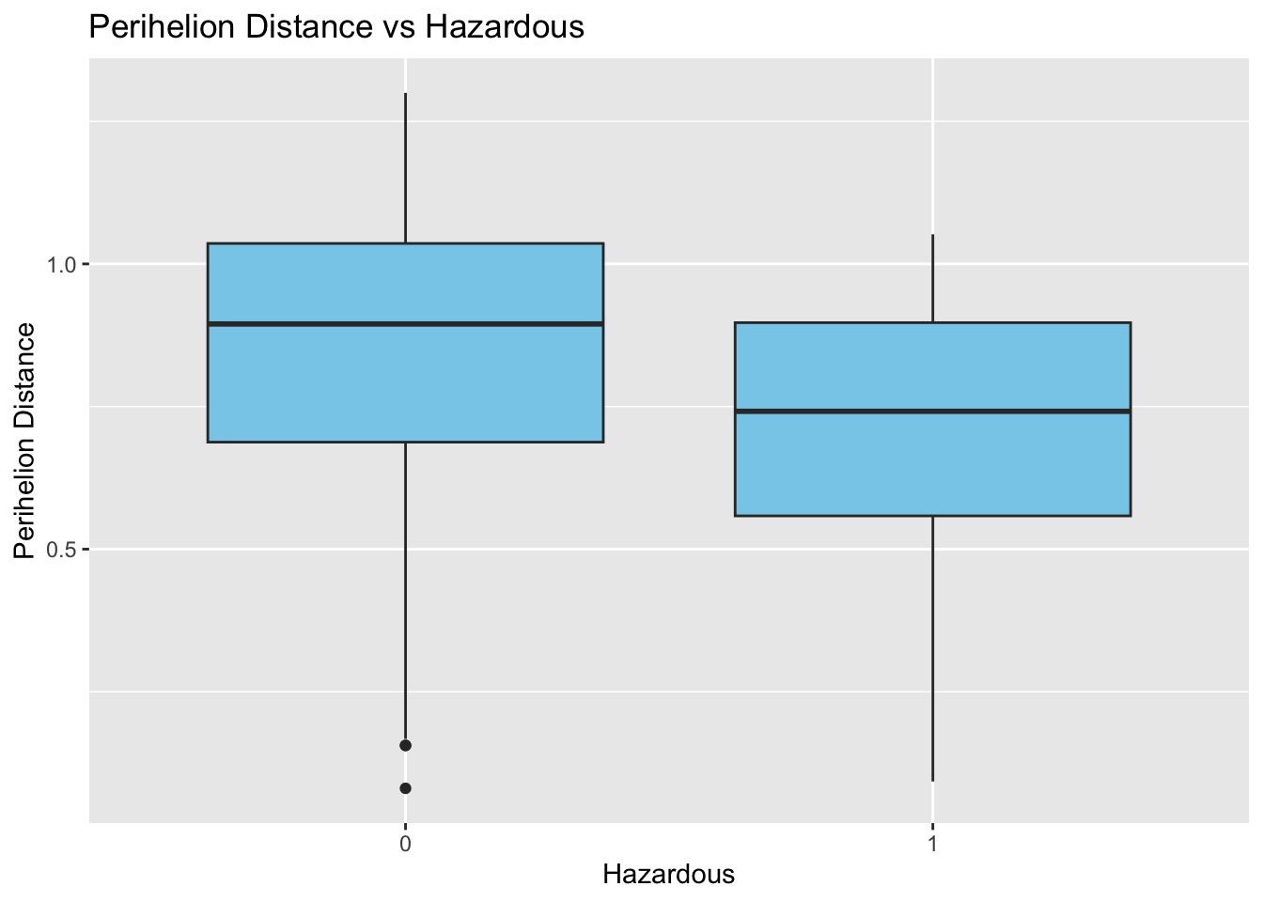
hazardous asteroids tend to have smaller perihelion distances overall compared to non-hazardous ones.

Slide 18
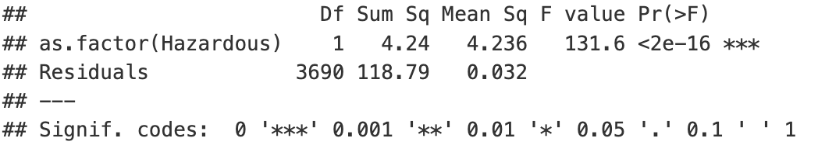
ANOVA on Eccentricity for Hazardous and Non-Hazardous
This indicates that there is a significant impact of eccentricity on asteroid hazard classification.

Slide 19
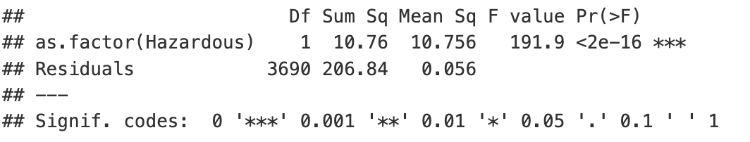
ANOVA on Perihelian Distance for Hazardous and Non-Hazardous
This confirms our previous findings that there is a significant impact of perihelion distance on asteroid hazard classification.

Slide 20
Smart Question 5: What are the most influential features in predicting whether an asteroid is hazardous ?

Slide 21
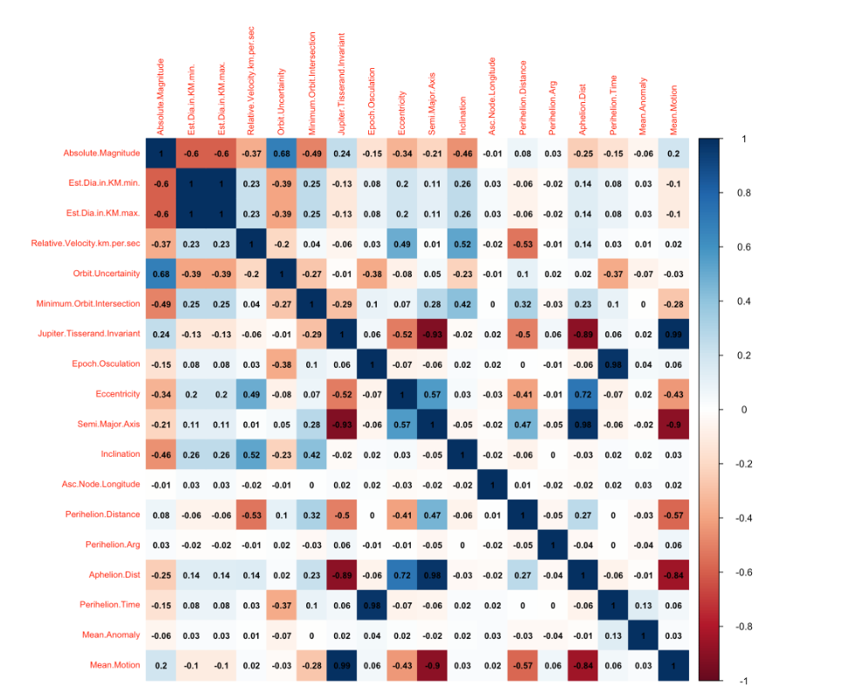
Correlation heatmap
Hazardous (the target variable) has a moderate negative correlation with the features, Absolute Magnitude, Minimum Orbit Intersection, and Eccentricity

Slide 22
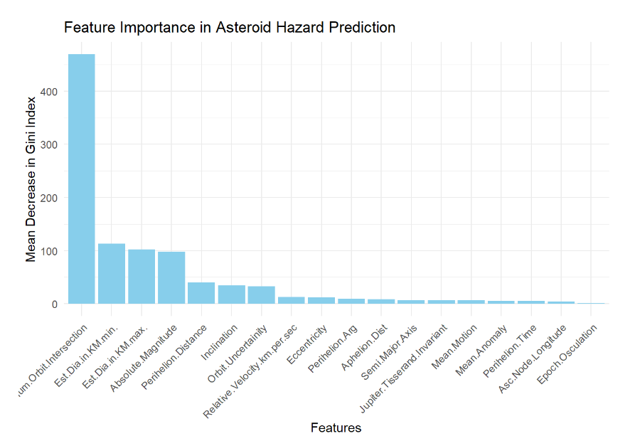

Slide 23
Thank you!

